Slide 1

Tracking Room Occupancy
Abhaya Rawal

Slide 2
Introduction
Create a binary classification model based on data gathered from various sensors.
The UCI Machine Learning Repository provides the dataset for this project, which includes Date, Temperature, Light, Sound, CO2 levels, PIR, and Room Occupancy Count.

Slide 3

Project Scope
Develop a binary classification model to forecast room occupancy using sensor data.
Investigating the dataset to learn more about its features
Machine learning techniques; Random Forests algorithm and Gaussian Naive Bayes
Proper Evaluation matrix; accuracy, precision, recall, and F1-score
Impact of the project in various fields; energy efficiency, resource allocation, safety, IoT applications, and environmental sustainability.

Slide 4

Methodology and Tools
Use of Python as the primary programming language
Libraries (Pandas, NumPy, Matplotlib, Seaborn, Scikit-Learn) for data preprocessing, exploration, and modeling.
Random Forest Algorithm: Ability to handle large datasets with higher dimensionality:
Effectiveness in handling categorical and numerical data (like temperature, CO2 levels).
Gaussian Naive Bayes : Gives a fast and highly scalable model for building and scoring.

Slide 5
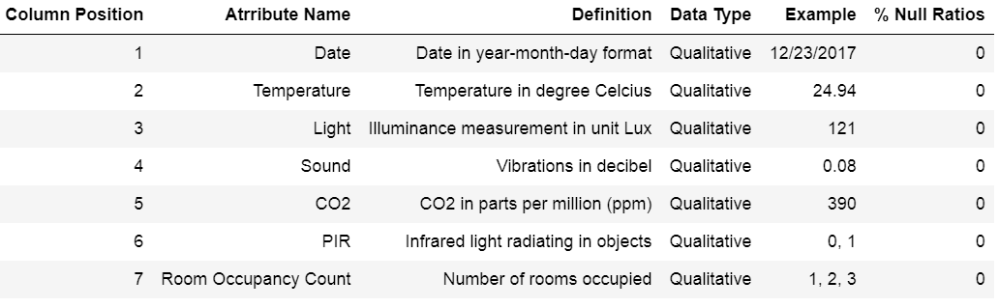
Dataset Overview
Data Dictionary
UCI Machine Learning Repository https://archive.ics.uci.edu/dataset/864/room+occupancy+estimation
Significant in indicating the presence of people in the room.
Data Loading, Splitting For training/testing, encoding categorical data

Slide 6
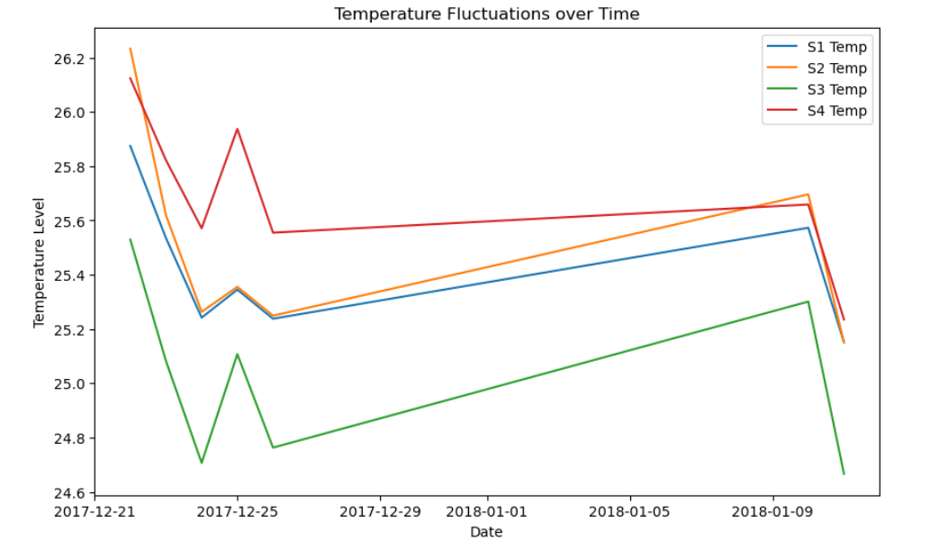
Exploratory Data Analysis

Slide 7
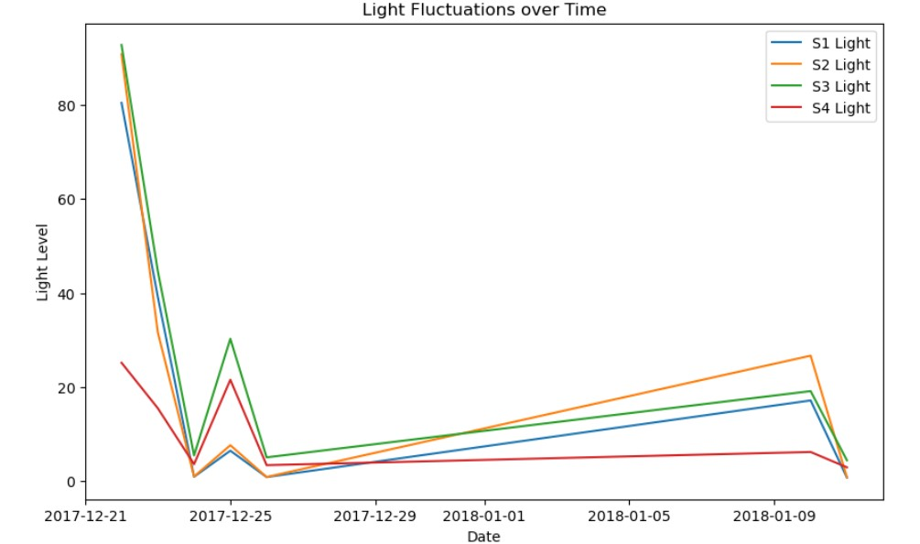
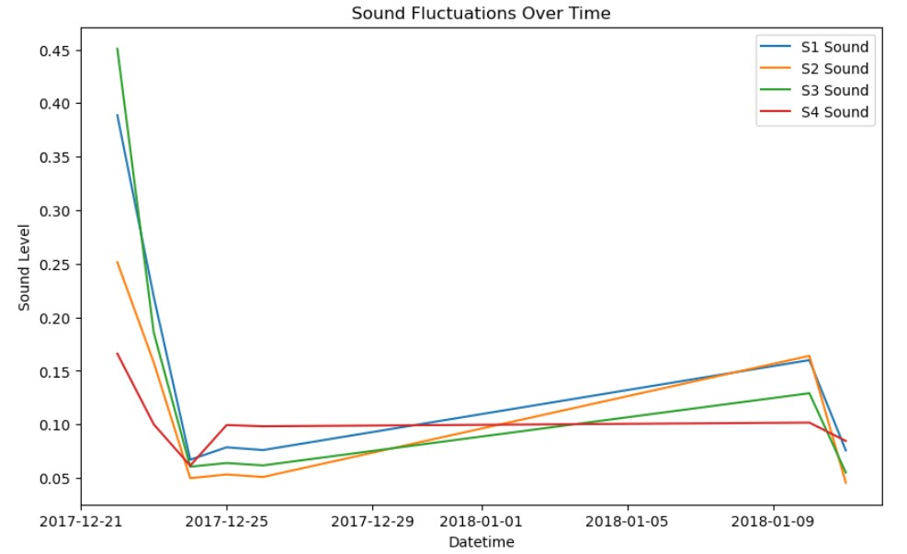
Contd.

Slide 8
Contd.

Slide 9
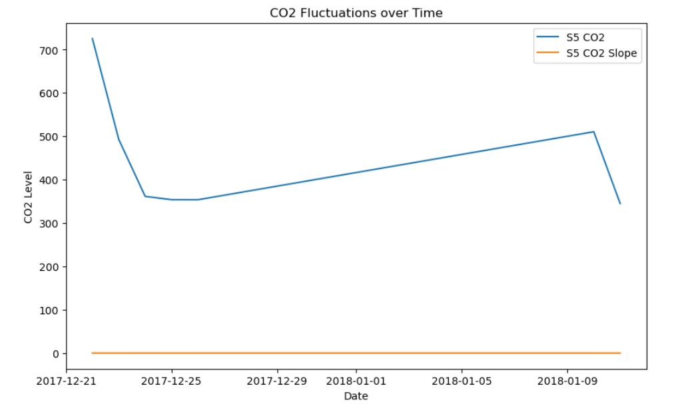
Contd.

Slide 10
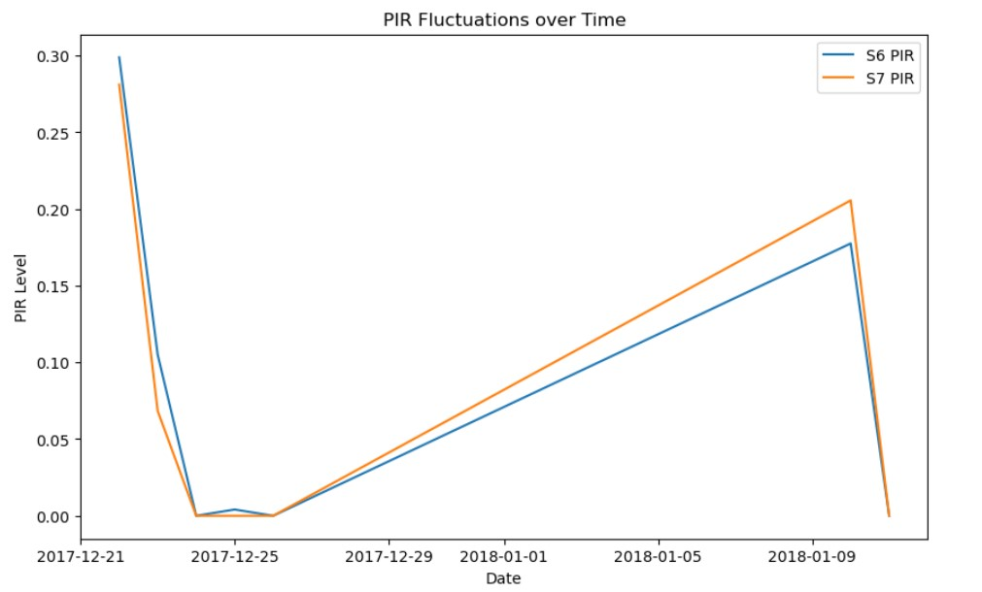
Contd.

Slide 11
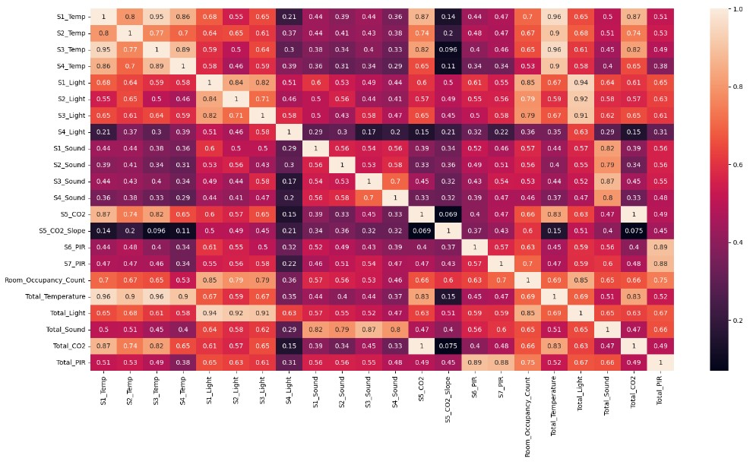
Contd.

Slide 12
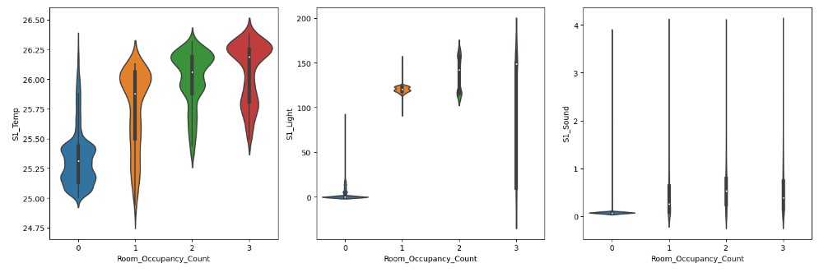
Contd.

Slide 13
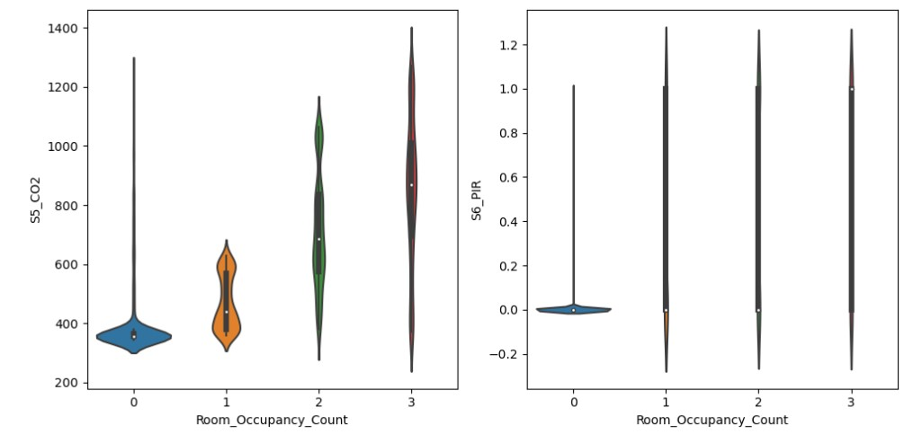
Contd.

Slide 14
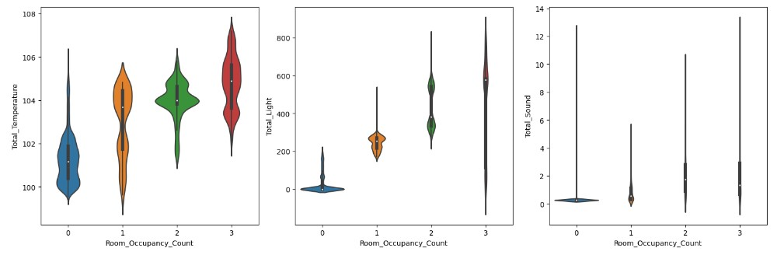
Contd.

Slide 15
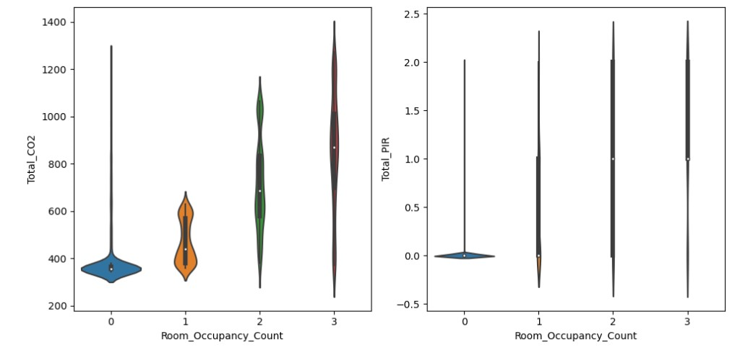
Contd.

Slide 16


Random Tree Classifier & Gaussian Naïve Bayes Classifier

Slide 17
Conclusion
Temperature, CO levels, and Light intensity are crucial indicators
Lays a robust foundation for future advancements
Random Forest Classifier emerges as the most effective model
Enabling Smart Building Automation

